Slide 1
Learning Outcomes
What is corporate culture?
Why are a company’s vision, mission, goals
and objectives relevant to me?
How do I know what’s expected of me?
How should I respond to these expectations?

Slide 2


Great Expectations
Professional Development

Slide 3
Introduction to the Module
Why “Professional Development”?

Slide 4
What is Corporate Culture?
Corporate culture refers to the ^{beliefs} and ^{behaviors} that determine how a company's employees and management interact and handle outside business transactions. Often, corporate culture is ^{implied} not expressly
_{defined, and} develops organically over time
from the cumulative traits of the people the company hires.
beliefs
behaviors
implied,
develops organically over time

Slide 5

What is Corporate Culture?
Experience
Make mistakes and learn from them
Collective Beliefs
Assumptions

Slide 6
Good Corporate Culture…
Creativity
Ability to adapt
Allows sharing ideas
Promotes healthy competition
Makes room for growth
Involves everyone

Slide 7
What are your thoughts on this?
https://www.youtube.com/watch?v=YsLoK3r3p7c

Slide 8
Negative Corporate Culture…
Negative energy
Poor leadership
Less trust and more micromanagement
Lack of creativity
One person has the power to influence positively or negatively

Slide 9
Discussion
What can you do to contribute to positive organizational culture?

Slide 10
Mission, Vision, Goals and Objectives…
What is a company’s Mission and its Vision?

Slide 11
Mission and Vision…
Why does the company exist?
Mission
What does it want to achieve in the future?
Vision

Slide 12
The Vision of a Company…
Define what you want to achieve
Goals
Actions to achieve the goals
Objectives

Slide 13

A Company’s Vision and Mission…
Has a Huge Impact On Decision Making

Slide 14
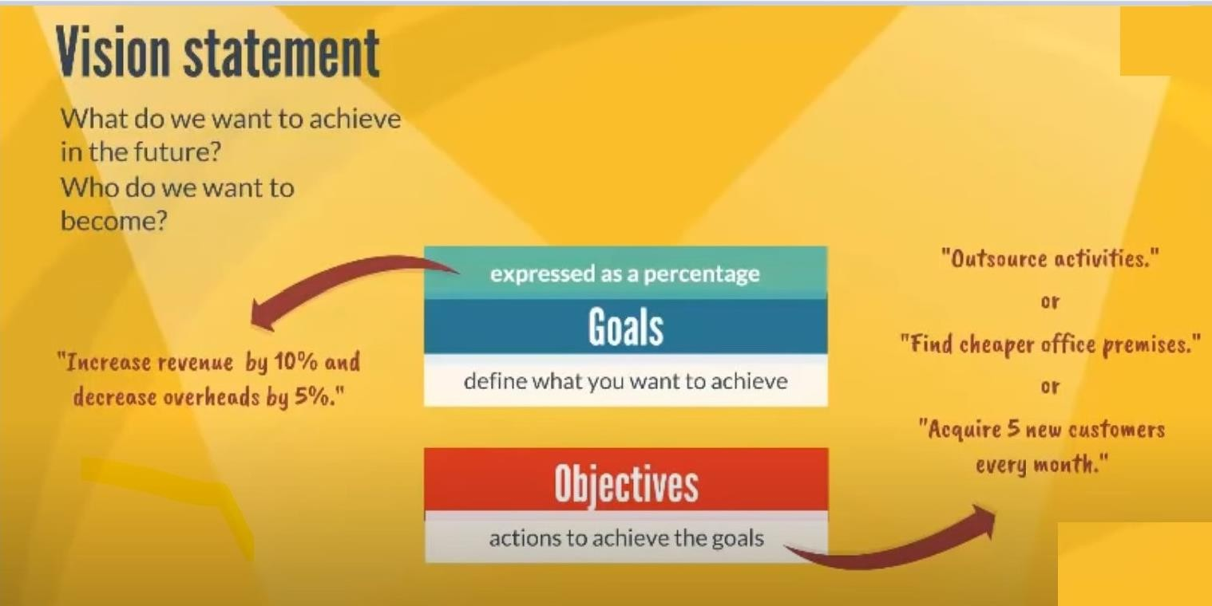
And Practically…

Slide 15
So why does it matter to me?

Slide 16
Mission, Vision, Goals & Objectives…
Helps me to know what I should focus on.
Helps me to understand what’s important to the company.
Gives me a hint of what my boss might be focused on so that I can align myself accordingly.
Helps me prioritize my work based on what’s important to the company.

Slide 17

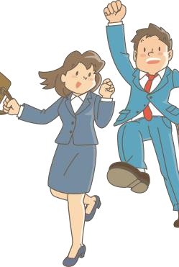
What is expected from me?
Long Term Potential
Enthusiasm and Passion

Slide 18


Putting Skills into Action
What do they want from me?
Team Player

Slide 19


What do they want from me?
Ambition
Giving Credit to Others

Slide 20


Result Producer
What do they want from me?
Fitting the Work Environment

Slide 21


Ability to Respond (Responsibility)
What do they want from me?
Integrity
Notes:
the qaluity of being honest and having moral principles

Slide 22
Even in a job interview bosses would like to see these qualities in candidates.

Slide 23
My Response…
Adjust my behavior thinking and actions to align with what the company needs in order to fulfill its mission, vision through its goals and objectives.
Consistently check if you’re in sync with the organization's expectations
Your superior
Your colleagues

Slide 24
Let’s Look at an Example on Teamwork

Slide 25
https://www.youtube.com/watch?v=_akanzNG30g
What is your take on the following video?
https://www.youtube.com/watch?v=0kkPmppKm_4

Slide 26
Learnings…
Effective facilitation
Accepted the blame as a team
Agreed on the issue
Didn’t blame each other
Thanked each other for their support
Agree to stay in touch – effective communication
Not dwelling on the problem but seeking a solution

Slide 27
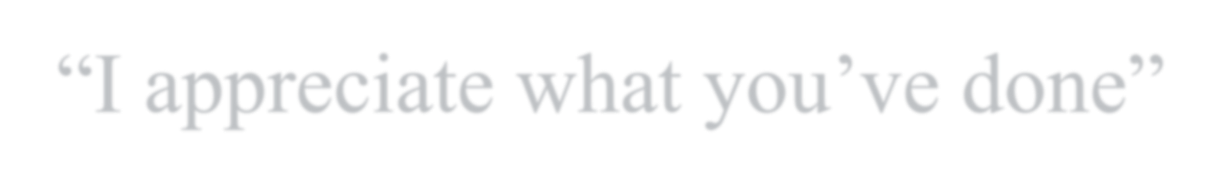

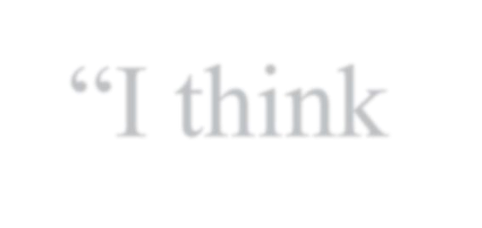


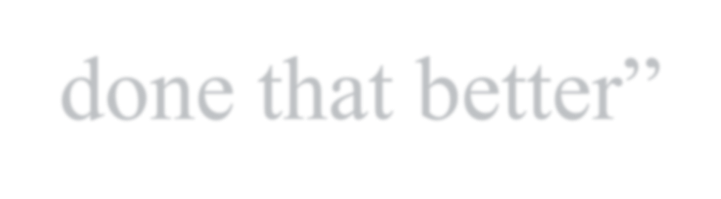

“Great Start”
Collaborative Language…
“I appreciate what you’ve done”
“I think we could have done that better”
“Thank you”

Slide 28

Inefficiency during a meeting and poor teamwork

Slide 29
Watch and Learn…
What are the phrases to avoid at work?
https://www.linkedin.com/learning/management-tips/5-phrases-to-avoid?resume=false&u=76664938
…

Slide 30
Activity…
As a team, discuss and list down practical ways in
which you can demonstrate positive attributes in a corporate setting.
Ask your team leader to share your thoughts in under 2 mins

Slide 31


